Slide 1
Final Project Proposal
Team no. 26

Slide 2

Our Team
Bhushan Bhujbal(PL)
Supriya Tiwari
Sana Desai
Ambar Ghadage
Vinod Tambe
Anupama Madane

Slide 3
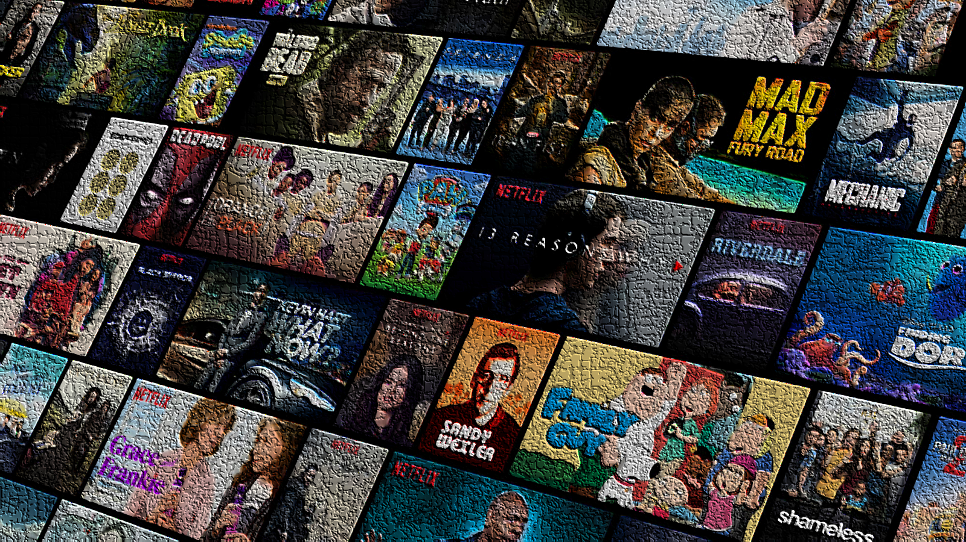
1. Movies Vila
Develop Movies Vila, a personalized movie streaming app, with a diverse movie collection, recommendations, user interactions. Aim to become the preferred platform for movie enthusiasts seeking a tailored and enjoyable movie-watching experience.
Key Features:
User-Friendly Interface
Curated Movie Collections
User Reviews and Ratings
Cross-Platform Accessibility
Extensive Movie Library

Slide 4
Future Scope of an OTT Platform
Producing Original Content
Global Expansion
Live Streaming and Events
Enhanced Personalization
Multi-Platform Support
Improved Offline Viewing

Slide 5

2. Shop Stop
Elevate your shoe shopping experience with the Shop Stop app. Explore a diverse range of stylish and comfortable footwear for all occasions. Enjoy seamless browsing, easy checkout, and access to exclusive shoe deals. Step into fashion-forward footwear with the Shop Stop app - your go-to destination for shoes that cater to your unique taste and preferences.
Key Features:
Wide Range of Fashion
Intuitive User Interface
Easy Search and Filters
Wishlist and Favorites
Seamless Payment Options

Slide 6
Future Scope of an E-Commerce
Product Diversification
Vendor Partnerships
International Shipping and Localization
Personalized Recommendations
Social Commerce Integration
Subscription and Membership Programs

Slide 7

3. Connect Buddy
Introduce Connect Buddy, a dynamic social networking app, facilitating meaningful connections and friendships. Offer interactive features like instant messaging, photo sharing, and engaging stories. The goal is to build an engaging social platform that brings people together and fosters lasting connections.
Key Features:
User Profiles and Bios
Instant Messaging
Posts and Sharing
Discover and Connect
Notifications

Slide 8
Future Scope of a Social Media App
Multimedia Content Enhancement
Live Streaming and Stories
AR Filters and Effects
In-App Shopping
Explore and Discover Features
Group Chats and Communities
Event and Meetup Integration

Slide 9

MERN Stack Technology
Frontend:
ReactJS: Frontend will be built using ReactJS, a powerful JavaScript library for creating interactive and dynamic user interfaces. React's component-based architecture enables efficient development and easy maintenance.
Redux Toolkit: Redux Toolkit is used for state management within the application. It simplifies the process of managing and updating the application's state, making it easier to handle complex data interactions.
Axios: Axios is utilized for handling HTTP requests from the frontend to the backend. It provides an easy-to-use interface for making asynchronous API calls.

Slide 10

MERN Stack Technology
Backend:
Node.js: The backend is powered by Node.js, a server-side JavaScript runtime. Node.js allows for fast and scalable development, making it an ideal choice for building the backend of a streaming application.
Express.js: Express.js is a web application framework for Node.js. It provides a minimalistic yet robust set of features to build APIs and handle routing in the application.
MongoDB: As a NoSQL database, MongoDB enables flexibility in storing and managing various types of content data, which is essential for an entertainment app with diverse media.
JWT (JSON Web Tokens): JWT is used for authentication and user session management. It allows users to securely log in, and the generated tokens are used to verify their identity for subsequent requests.

Slide 11
THANK YOU!

